Slide 1

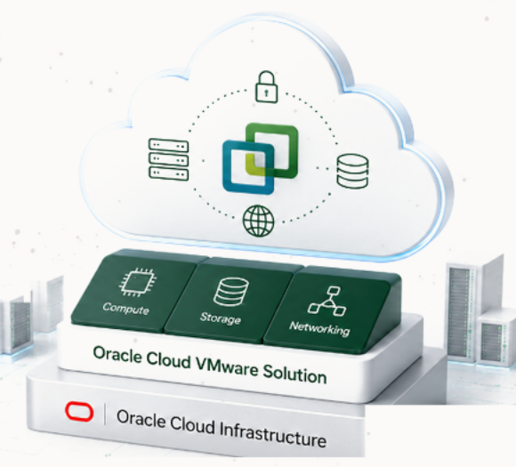




Oracle Cloud
VMware Solution
Proposed Sizing
Customer
CLIENT
Date
May 2025
Prepared By
Oracle Cloud VMware Specialist
Notes:
[Sources]
Source: slide 1 of the provided PowerPoint. Oracle logo, Oracle mark, row icons, and the right-side Oracle Cloud VMware Solution illustration are kept as cropped image assets from the source. Visible title, sizing label, and customer/date/prepared-by text are editable PowerPoint objects.

Slide 2






























Capacity Expansion with Oracle Cloud VMware Solution
Extend VMware capacity on demand while maintaining operational consistency.
Business continuity for
mission-critical applications
Maintain systems without
service disruption
Ensure recovery from
data corruption & cyberattacks
Meet defined RTO & RPO
with backups & restores
BUSINESS OUTCOMES
On-demand capacity
ON-PREMISES ENVIRONMENT
ORACLE CLOUD VMWARE SOLUTION (OCVS)
Add resources as needed.
CAPACITY EXPANSION
No additional
data center hardware
Your Existing
VMware Environment
Extend your VMware environment
on Oracle Cloud Infrastructure
Avoid upfront capital investment.
Consistent VMware
operations
HCX Mobility
Capacity constraints
Secure workload mobility over
Internet, VPN, or FastConnect
Use the same tools and skills.
Seasonal demand
Compute
Storage
Network
Scale up and down
as needed
Business growth
Internet
FastConnect
Elastic capacity for your business.
VPN
Hardware procurement delays
Customer-managed VMware Cloud Foundation
on native OCI infrastructure
Faster response
to business demand
Secure
High Performance
Private Connectivity
Reduce time to deliver capacity.
Expand capacity when needed while preserving the VMware tools, processes, and skills your teams already know.
1
Copyright © 2026, Oracle and/or its affiliates.
Confidential: Internal/Restricted/Highly Restricted
Notes:
[Sources]
Source: user-provided screenshot. Oracle/OCI logo, VMware cloud logo, top benefit icons, on-premises icons, capacity expansion icons, target-card icons, business-outcome icons, and bottom target icon are retained as cropped image assets from the screenshot. Title, subtitle, panels, arrows, labels, descriptions, callout and footer are recreated as editable PowerPoint objects.

Slide 3













Current Environment
Analysis based on RVTools data shared by the customer.
Datacenter 1 – CLIENT
VMs
vCPUs
vRAM (GB)
Storage (TB)
20,100
3,000
30,000
210
18,400
Powered On
1,700
Powered Off
Total VMs
Total vCPUs
Total vRAM (GB)
Total Storage (TB)
20,100
3,000
30,000
210
Total Environment
18,400 Powered On
1,700 Powered Off
This sizing is based on the information available at the time of analysis and should be validated during the detailed design phase.
Copyright © 2026, Oracle and/or its affiliates | Confidential: Internal/Restricted/Highly Restricted
Notes:
[Sources]
Source image: user-provided screenshot "Current Environment". Oracle logo, Oracle mark, datacenter icon, metric icons, total-environment icon, and information icon are embedded as cropped image assets from that screenshot. The visible title, subtitle, panel headers, labels, metric values, notes, footer, cards, separators, and decorative background elements are recreated as editable PowerPoint objects.

Slide 4









Assumptions & Methodology
The proposed sizing is based on the information provided by the customer
and the following assumptions and methodology.
Sizing Methodology
Data Source
RVTools export provided by the customer
(Analysis Date: May 08, 2025)
Sizing Approach
Capacity based on current utilization
and projected growth
CPU Contention Ratio
1:6
(Industry standard for medium consolidation)
Average Utilization
vCPU: 50%
vMEM: 60%
Target Utilization
80%
(For both vCPU and vMEM)
Storage Type
OCI Block Volume
(Block Storage)
Copyright © 2026, Oracle and/or its affiliates | Confidential: Internal/Restricted/Highly Restricted

Slide 5





Infrastructure Sizing Summary
The following architecture on Oracle Cloud VMware Solution (OCVS) has been designed
to support the customer's current environment with room for future growth.
Proposed Architecture
Cluster Distribution
SDDCs
1
Clusters
1
Production
Hosts
4
Shape
AMD E4
4
x AMD E4
Storage
200 TB
200
TB
Storage Type
OCI Block Volume
Right-sized architecture designed to support current workloads and future growth
while optimizing cost and performance.
Copyright © 2026, Oracle and/or its affiliates | Confidential: Internal/Restricted/Highly Restricted
Notes:
[Sources]
Source: slide 3 of the provided PowerPoint. Oracle logo, Oracle mark, and all metric/panel icons are kept as cropped image assets from the source. Title, explanatory text, architecture table, cluster card, values, callout, footer, panels, and separators are recreated as editable PowerPoint objects.

Slide 6

Confidential - Oracle Restricted \Employees
Only
Confidential - Oracle Restricted \Employees
Only
Notes:
[Sources]
Source: slide 4 of the provided PowerPoint. Oracle logo is kept as a cropped image asset from the source; confidentiality labels and grey background are editable PowerPoint objects.

